Slide 1


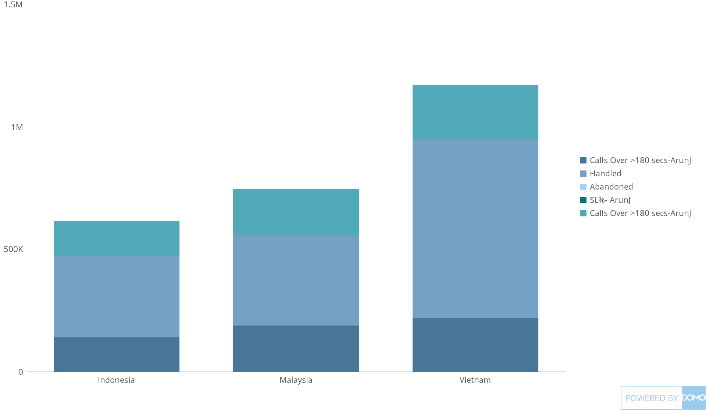
+
exported May 17, 2025, 12:33:00 PM UTC
PE 1 | CARD 6| Country wise -MTD Performance(Offered VS Handled Vs SL)
This Year

